Slide 1
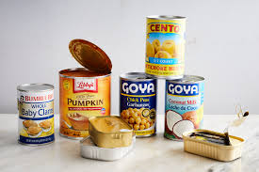
A business proposal for manufacturing of canned food in South Korea.
Image link: https://www.google.com/imgres?imgurl=https%3A%2F%2Fstatic01.nyt.com%2Fimages%2F2019%2F09%2F25%2Fdining%2F20cans1%2Fmerlin_160763178_71b0d03a-d399-4d81-ac4d-db47d601c594-superJumbo.jpg
June 23rd 2020
Group
Student name:

Slide 2

Agenda
How will the investments be used?
What is the potential ROI for the company?
What is the market analysis and plan?
What is the five-year plan for growth?
Image link: https://www.google.com/imgres?imgurl=https%3A%2F%2Fc8.alamy.com

Slide 3

Introduction.
An investor refers to a person or a firm that takes part in another business by allocating capital with the aim of getting a financial profit in future (Hyder, 2012).
Food industry is a large and dynamic industry that operates all over the world (Beske, 2013).
This business proposal focuses on using South Korean investors to set up a canned food industry unit in Seoul, South Korea
Image link: https://www.google.com/imgres?imgurl=https%3A%2F%2Fharrisonglobalcapital.files.wordpress.
Notes:
Consumers have high hopes for security of food and the manufactures have a high demand of delivering foods to customers over a longer period of time. This led to the idea of expanding the canned food industry to South Korea with investment based from the South Korean government and private Companies.
The ecological, social and economical dimensions are what led to the circumstances in which the food is manufactured, sold and offered to consumers (Beske, 2013). For instance, the spread of the COVID-19 pandemic all over the world led to total lock down in most parts of the world. Most consumers depend on canned food because they can go a longer period of time without getting spoilt and it helped the self quarantined citizens of major countries to avoid unnecessary movements.
The sustainable supply chain management allowed food companies to take charge of the supply chain and be in control of competive advantages over other companies (Beske, 2013).
According to this research, the results showed that methods and practices in the supply chain were to be utilized, traceability and tracking of the canned food all over the world can enhance the quality of their food and it would help fulfil the customers demand.
Heyder(2012) adds that improving the tracking system will improve the status of the company in order to show how the investors perceive their importance and how the investment would benefit both parties.

Slide 4
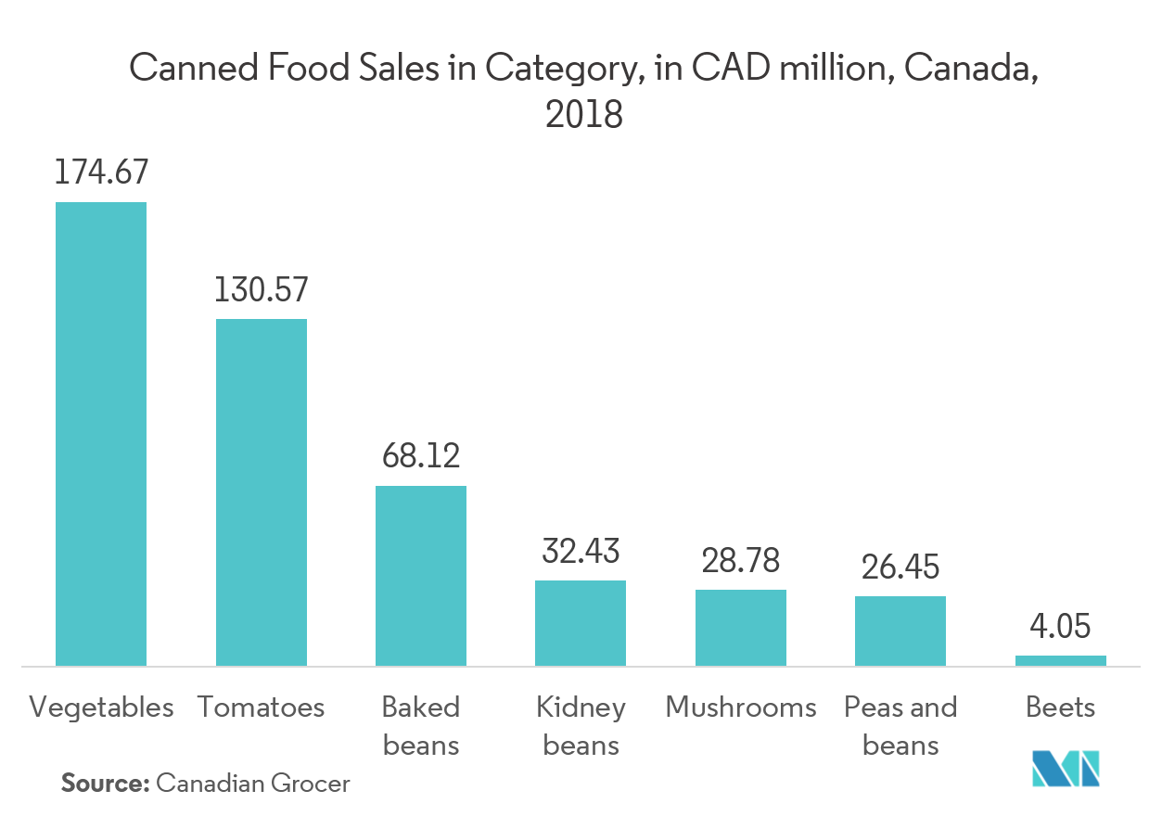
Background study.
The increase in demand of canned food, such as fish has led to raise in awareness of the nutritional benefits brought by the food industry.
Image link: https://mordorintelligence.com/images_db/RD_Images/1556168667974_Picture1.png
Source: Grand View Research. (2018)
Notes:
Based on the research done by the United Nations on food and agricultural organization, Asia- pacific continent has been named as the largest exporters and importers of canned food (Downing, 2019). Having this fact in mind, South Korea would be the best place to start a business of canned food by manufacturing the food locally in South Korea and selling them internationally.
The graph shows the research of the statistics of the canned food industry in the year 2018. the Canadian market size was projected to almost 12. 35 billion dollars and the demand is to be estimated at 20 billion dollars at the years 2025.
These canned food include vegetables, fruits, meat products and ready meals. These canned foods have been seen to grow in the canadian market since they reduce hypertension, osteoporosis and so on.
The canned food industry is featured by low margins and high volumes of the products where the companies with weak supply power are expected to source resources and labor from large companies (Downing, 2018).
The growth of the food industry in general has led to the growth of canned food industry in Canada hence the need to develop a company that does the same.

Slide 5
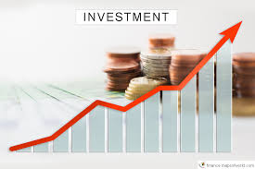
How the invested money will be used.
  The amount of investment needed from investors will be $1.2 billion distributed in the following categories.
    The investment will be used to locate raw materials that would be used for the manufacturing. ($600,000)
    Payment of workers ($100,000)
    Ensuring legal requirements are met .($100,000)
    Doing market analysis and coming up with strategies .($100,000)
    Others ($250,000)
Image link: https://www.google.com/imgres?imgurl=https%3A%2F%2Fcdn.steemitimages.com
Notes:
Investors can benefit in their investment in the following ways:
Profits- the main purpose of investing in a business is to gain profits at a later time. Investors aim at getting wealth by putting their savings into solid businesses that will grow year after year
Globalization- investing in a company of other countries can improve global relations among the participating countries hence creates more chance of business opportunities. Investors can also gain influence from the foreigners. (Peifer, 2014)
Tax saving- Charges put on investment taxes are usually lower than non-investment taxes. This is because most government reduce the funds they have to pay during their retirement ages so that investors can fund their retirements.
The importance of cost in any business involves setting the standards of an industry, planning the tariffs and controlling of the finances being set on different departments of the project. Cost controlling can help in ensuring the efficient running of a company and that profits are maximized. Cost control will also ensure that customers are able to receive the products at normal prices. Cost benefit analysis will help determine how the cost is allocated in different places.
Setting up locations for industries is complex. It requires the project managers to take into consideration factors such as land, availability, water availability, capital, transport availability and market availability both local and international markets. Industry should be set up after a market strategy and analysis studies have been done o ensure that an industry can get new customers and new customers can also find you without difficulties.
According to a research study(Tang, 2006), population is on of the major determinants of construction, whether residential or non-residential. This research showed that that the enlargement of a manufacturing industry is a factor that affects the construction of non-residential construction.
A higher population means a higher market hence large amounts of profits.

Slide 6
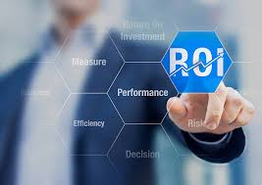
Potential ROI
Based on the statistics of growth of the canned food industry, the potential ROI for investors should be in the ratio 6:1. This means that the net profit should be six times higher than the net worth so that the investors can get their returns in abundant.
For instance, with the ROI of 6:1 and the investment is $1.2B, then the investor is expected to get a net profit of $200,000 , the ROI becomes 16.66%
Image link: https://www.google.com/imgres?imgurl=https%3A%2F%2Fmedia.istockphoto.com
Notes:
To ensure the net profits are met the following should be considered
Demand- increase in demand for canned food in canada leads to higher equilibrium price and higher quantity production (Wisner, 2014).
Location- a good area will provide a good market for any business since a good location provides immense number of customers (Davidson, 1980).
Resource availability- this refers to having the necessary resources at a given time with a necessary skill set.
The increase in demand of canned food in
canada led to the need of opening a business in South Korea that manufactures canned food due to the availability of enough labor and ready market for canned food since South Korea is one of the largest importers and exporters of canned foods. For instance, the corona virus pandemic has led to world wide requirement of canned food due to closure of grocery stores and other businesses.
Location influences the way a business operates. For instance, if the canned food industry is located in a city, it will yield more profit than when in a rural area. The firm should also be in close proximity to agricultural areas in order to get a lot of supply of resources such as vegetables, legumes and sea foods if close to the lakes and oceans.
Starting a canned food industry will require the availability of qualified professions such as industrial chemists since these processes require a lot of strict attention to avoid creating poisonous food substances. Continuous flow of raw materials and effective labor are also needed to ensure that the operations of the industry after it is built runs effectively.

Slide 7
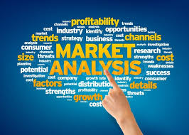
Market analysis and plan.
  Market analysis refers to an assessment of the market, both Qualitative and quantitative. It takes into consideration the size of the market and the buying patterns and the competition.
  This study aims at doing market analysis by determinizing the price, the place and the products that would sell best. Therefore, there is a likeliness that the canned food will sell in the target market.
  It will involve coming with advertisement methods and promotions to the people of Seoul , in order to penetrate their market.
  The target customers will be the general market of South Korea and the rest of the world.
  The product aims customers of ages six to seventy-five.
  Image link: https://www.google.com/imgres?imgurl=https%3A%2F%2Flawofchoices.com
Notes:
Market analysis also involves checking the economical environment in terms of entry and exit of market as well as regulations of the market area. A market analysis can be done by determining the purpose of your research, checking the outlook of the company, determining ones potential customers and comparing your company to the competitors to determine where to start. After all this, the researcher needs to gather more information, analyze the findings then put the market analysis into action (Wisner, 2014).
One can also determine the interconnection between the demand and the supply for one’s product and forecast the likeliness of the successfulness of the company. Market analysis will differ from industry to industry.
Market analysis also involves understanding how the customers needs and behaviors are changing so that you can change the compositions and details of the product as their needs change.

Slide 8
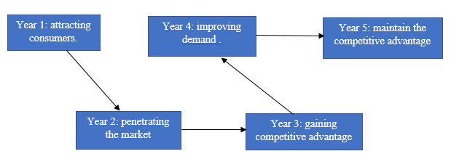
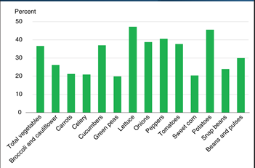
Five-year plan for growth.
  The first and second year of the company’s operation will involve penetrating the market and getting consumers to check out the company’s products. It will involve frequent marketing and advertisements.
  The third year and the fourth year would involve gaining competitive advantage in the South Korean Market.
  The fifth year would be to ensure that the demand for the company's products have improved and the sales are up to almost a million dollars.
  Image link: https://www.google.com/imgres?imgurl=http%3A%2F%2Fwww.businessengineroom.com%
Notes:
Building this industry in Soeul, South Korea will help fulfil the five year plan due to the following reasons:
Cost- the cost building and setting up machinery in South Korea is very low as compared to Canada due to the availability of well developed manufacturing industries.
Location- the location of South Korea as a country facilitates international market to its neighboring countries and the Asia continent in general.
Population- the large population of South Korea provides a ready market for the manufactured products and the ready labor. South Korea has effective professions that can improve the processing processes.
A growth plan will enable the canned food unit to be differentiated from the customer. It also ensures that the company focuses on developing the products that best fit what the customers values. It generally involves establishing the value proposition in long term growth, identifying the effective customers, looking at the competition and focusing on the strengths of the organization.
Ensuring that a business grows will involve the executive to hire the right team, keep the current customers happy while looking for new customers. The four major strategies as discussed above involves, market penetration, development of the product, expansion of the market and diversification of the product.

Slide 9
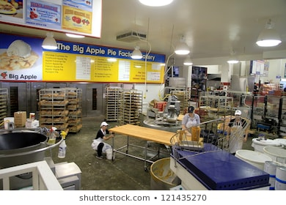
Conclusion.
Investing in a canned food industry will ensure that the investors can make profits as the business growiin Soeul, South Korea without participating in day to day activities of the industry. An investor should consider the net gain that he will gain when the company has overtime, the stability of the company, the price to earnings ratio and the dividends of the project.
Image link: https://www.shutterstock.com/image-photo/colborne-ontario-october-8-internal-view-121435270
Notes:
Therefore, in order to make sure investors are attracted to your business, project managers and executives should ensure that their debt to equity ratio is low and their price to earning ratios are high. Investors can have financial security and income from the companies that they invest in.
Return On Investment(ROI) is the level of profitability that is used to determine the performance of a company. It is usually calculated by dividing the net profit of a company by the total assets of the company.
For instance, a good marketing ROI should be 5: 1 and a bad marketing ROI is a negative which shows that the company experienced losses. Investors have to do an analysis of an industry to ensure that they do not experience losses and end up with less than they would have if they had done nothing with their money. Most investors think of return on investments in terms of currency.

Slide 10

Conclusion
Globalization can help investors attain the connection to people and businesses all over the world. This leads to growth o global political, economical, social and cultural integration. Integration can ensure that businesses are conducted in harmonious environments.
It should be noted that poor investments can bring risks to return on investment, stake ownership in an industry and time wasted on the investment cannot be returned. Therefore a company should ensure that the investments trusted to them should be used effectively.
Image link: https://www.google.com/search?q=globalization+photos&rlz=1C1CHBF
Notes:
For instance the company should not use the investments on unnecessary labor, raw materials and they should implement outsourcing of extra services to ensure that company only concentrates on the sole purpose of the company. In is case, the industry should only concentrate on the manufacturing of canned food.
Accounts such as 401k, the RRSP and the TFSA are responsible for the taxation of your investment and they ensure that the taxes are lower or non-existent.
The use of index investment will ensure that the investor is able to mimic the index but at very low fees and the investors can get good returns even if the investment is low.

Slide 11
Sources.
Beske, P., Land, A., & Seuring, S. (2014). Sustainable supply chain management practices and dynamic capabilities in the food industry: A critical analysis of the literature. International journal of production economics, 152, 131-143.
Heyder, M., Theuvsen, L., & Hollmann-Hespos, T. (2012). Investments in tracking and tracing systems in the food industry: a PLS analysis. Food Policy, 37(1), 102-113.
Downing, D. L. (2013). A complete course in canning and related processes: processing procedures for canned food products. Elsevier.
Martinez, S., & Paudel, K. P. (2018). Food marketing in the canada. In The Routledge Handbook of Agricultural Economics (pp. 108-133). Routledge.

Slide 12
Sources.
Davidson, W. H. (1980). The location of foreign direct investment activity: Country characteristics and experience effects. Journal of international business studies, 11(2), 9-22.
Wisner, J. D., Tan, K. C., & Leong, G. K. (2014). Principles of supply chain management: A balanced approach. Cengage Learning.
Tang, J. C., Karasudhi, P., & Tachopiyagoon, P. (1990). Thai construction industry: demand and projection. Construction Management and Economics, 8(3), 249-257.
Peifer, J. L. (2014). Fund loyalty among socially responsible investors: The importance of the economic and ethical domains. Journal of Business Ethics, 121(4), 635-649.

